Slide 1
PMCA601 Full Stack Web technology
Module – 7 Full Stack Integration and Deployment
NoSQL Database – MongoDB Basics – Documents, Collections, Database, Query Language, Installation, The Mongo Shell – MongoDB CRUD Operations – MongoDB Node.js Driver – Schema Initialization – Reading from MongoDB – Writing to MongoDB

Slide 2
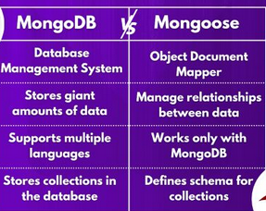
Mongoose Introduction
Mongoose is an Object Data Modeling (ODM) library for MongoDB. MongoDB is a NoSQL database and Mongoose is used to interact with MongoDB by providing a schema-based solution. The Mongoose acts as the abstraction layer over the MongoDB database. It is generally preferred over using normal MongoDB because it simplifies the process of sending complex queries.

Slide 3
Mongoose Advantages
Schema Definition: Mongoose allows you to define structured schema model for MongoDB collections, because of that you get a clear understanding about the structure of model data.
Data Validation: It can be used for data validation, which ensures that only valid and properly formatted data is stored in the database, which helps to manage data integrity.
Middleware Support: Mongoose has the support of middleware which helps in the execution of custom logic before or after database operations, that offers flexibility in handling data interactions.
Query Building: We don’t have to write those complex queries which we were writing in MongoDB because Mongoose simplifies the process by providing a high-level API that makes it easier to interact with the database.
Modeling Relationships and Population: You can define relationships between different data models and it also supports population, due to this you can work with related data without disturbing database normalization.

Slide 4
Mongoose Commands
Commands | Description | Example
save() | It facilitates the process of storing the document, along with its associated data, in the designated MongoDB collection, | ModelObj.save()
remove() | is used to remove the documents from the database according to the condition. | Model.remove({cgpa:{$lt:4})
exists() | returns the first id of the document if at least one document exists in the database that matches the given filter, otherwise null. | Model.exists({name:’Anand’})
updateMany() | is used to update one document in the database without returning it | Model.updateMany({dept:’IT’}, {dept:’Information Technology’})
find() | is used to list all data from the MongoDB database. | Model.find()

Slide 5
Mongoose Installation
In order to access MongoDB database through Node.js, the following modules are to be installed:
1. native mongodb has to be installed with the following command in node js environment:
>npm install mongodb
This will include mongodb folder inside node_modules folder.
2. Install, mongoose middleware as shown below:
>npm install mongoose
This creates mongoose folder inside node_modules folder.

Slide 6
MongoDB Through Node.js
Accessing MongoDB:
Import mongoose module. Create an object to refer this.
const mongooseObj = require(‘mongoose’)

Slide 7
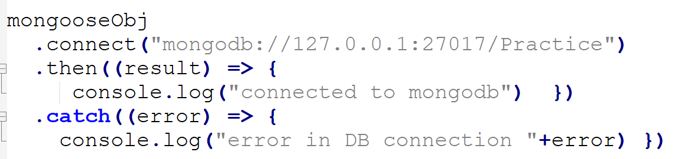
MongoDB Through Node.js
2. Establish the connection with MongoDB through the function connect with the connection string. The connection string is: mongodb://localhost:27017. Generally, MongoDB can access through the port 27017. attach the database name with the connection string. Here, Practice is the database. MongoDB is casesensitive.
Here, connection created with a call back function and exception handling

Slide 8
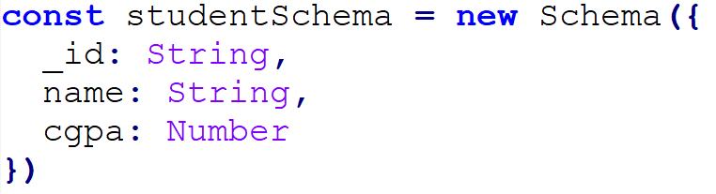
MongoDB Through Node.js
3. Define a schema as the structure of the collection.
Here, the collection has _id (default key), name and cgpa as keys.
Schema in Mongoose defines the structure of the documents in a MongoDB collection.Here, studentSchema defines a Student collection with the following fields:_id: String (Usually, MongoDB generates _id automatically, but here it’s explicitly defined.)name: Stringcgpa:Number
4. Attach the schema with the model of the collection for query process:
This model can use the MongoDB collection ‘students’ if it is existing, otherwise will create the collection ‘students’

Slide 9
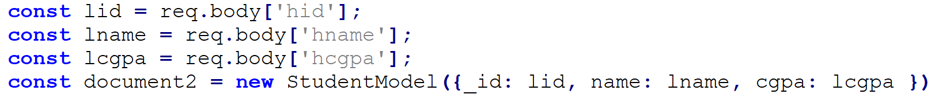
MongoDB Through Node.js
5. Attach the data with the object of schema.
OR

Slide 10
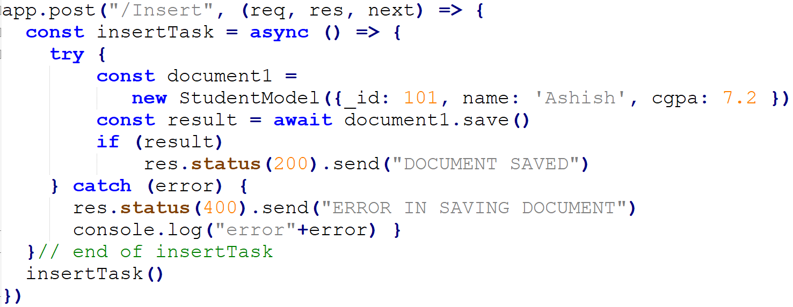
MongoDB Through Node.js
6. Use the Mongoose commands inside an asynchronous functions with the ‘await’ keyword. Below snippet inserts a new document:
OR

Slide 11
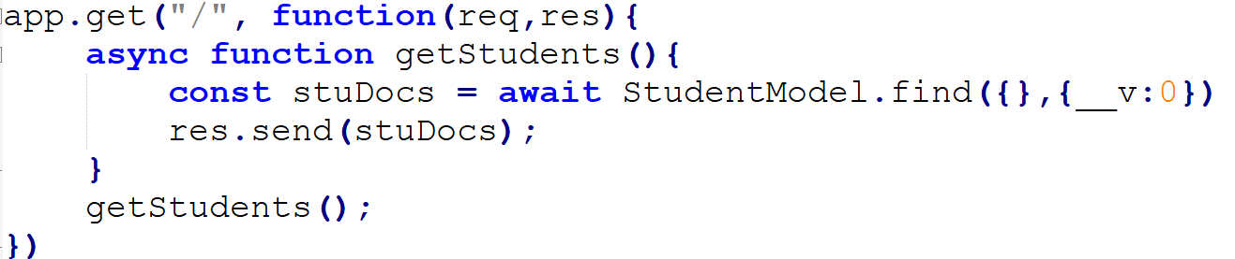
MongoDB Through Node.js
List Documents
OR
The await keyword is used inside an async function to pause its execution and wait for a Promise to resolve before continuing.
The asynchronous function returns an implicit Promise as a result. The async function helps to write promise-based code asynchronously via the event loop. Async functions will always return a value. Await function can be used inside the asynchronous function to wait for the promise. This forces the code to wait until the promise returns a result.
Hence we are using async for insDocFunc & app.post(…)

Slide 12
MongoDB – References
https://www.w3schools.com/mongodb/
https://www.tutorialspoint.com/mongodb/index.htm
https://www.tutorialsteacher.com/mongodb

